Slide 1
Sequence assembly using paired-end short tags
Pramila Ariyaratne
Genome Institute of Singapore
SOC-FOS-SICS Joint Workshop on Computational Analysis of DNA
13 July 2009

Slide 2
Overview
Genome sequencing
  Interrogating the genome of a particular species to discover its constituting DNA sequence.
  Has both wet-lab and dry-lab (bioinformatics) component.

Slide 3
Overview
A complete chromosome can range from a few thousands of bps to a few hundred millions.
Maximum sequence-able fragment (read) length a is ~ 500-1,000 bps.
Therefore needs whole genome shotgun sequencing approach.

Slide 4
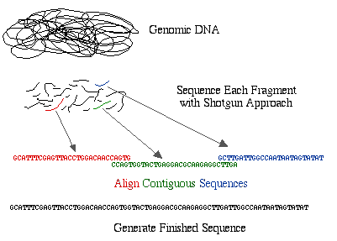
Overview
Whole genome shotgun sequencing.
Illustration from http://www.bio.davidson.edu/courses/GENOMICS/method/shotgun.html

Slide 5
Traditional approach
Sequence shotgun fragments of length 600 bps using Sanger capillary sequencing.
~ 10x coverage / sequencing depth.
Assembled using overlap-layout-consensus approach.

Slide 6
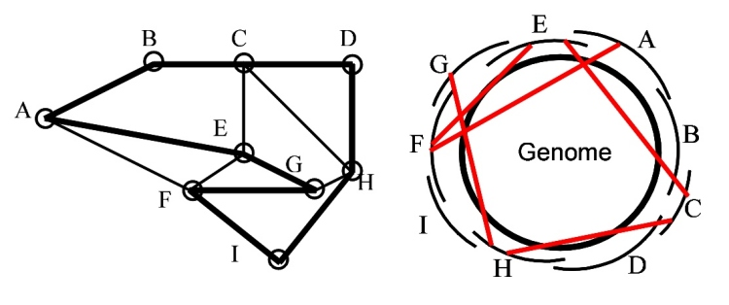
Traditional approach
Overlap-layout-consensus method for assembly.
  Build an overlap graph where each node represents a read. An edge exists between two reads if they overlap.
  Traverse the graph to find unambiguous paths which form contigs.
Illustration from http://www.cbcb.umd.edu/research/assembly_primer.shtml

Slide 7
Traditional approach
Sanger capillary sequencing is very slow.
384 sequences / day (0.4 million bps)
  10x coverage of human genome: ~30gbps

Slide 8
Next-generation sequencing
Alternative sequencing technologies to capillary, introduced in mid 2000s.
Systems by Illumina Solexa and ABI SOLiD.
  Much higher throughput (1-4gbps / day)
Lower cost / base pair
  Very short fragment lengths (25-75bps)
High error rate
Inherent ability to do paired-end (mate-pair) sequencing.

Slide 9
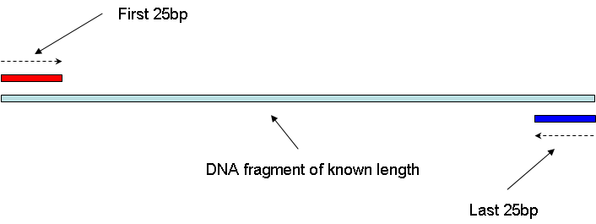
Next generation sequencing
Paired-End sequencing (Mate pairs)
  Sequence two ends of a fragment of known size.
  Currently fragment length (insert size) can range from 200 bps – 10,000 bps

Slide 10
Next-generation sequencing
Challenging to assembly data.
Short fragment length = very small overlap therefore many false overlaps
Sequenced up to 100x coverage, increase in data size.
Large number of reads + short overlap + higher error rate make traditional overlap - layout - consensus approach impractical.

Slide 11
Current approaches
Euler / De Bruijn approach.
Introduced as a alternative to overlap-layout-consensus approach in capillary sequencing.
More suited for short read assembly.
Based on De Bruijn graph.
Implemented in Velvet¹, the mostly used short read assembly method at present.
¹Daniel Zerbino and Ewan Birney. Velvet: Algorithms for De Novo Short Read Assembly Using De Bruijn Graphs. Genome Res. 18: 821-829. 2008

Slide 12
De Bruijn graph method
Break each read sequence in to overlapping fragments of size k. (k-mers)
Form De Bruijn graph such that each (k-1)-mer represents a node in the graph.
Edge exists between node a to b iff there exists a k-mer such that is prefix is a and suffix is b.
Traverse the graph in unambiguous path to form contigs.

Slide 13
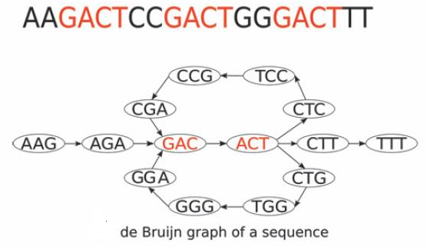
De Bruijn graph
K = 4

Slide 14
De Bruijn graph method / Velvet
Elegant way of representing the problem.
Very fast execution.
Error correction can be handled in the graph.
De Bruijn graph size can be huge.
  ~200GB for human genomes.
Does not use pair information in initial phase, resulting in overly complicated graphs.
Therefore we devised our own approach.

Slide 15
Our approach
Based on ‘Overlap extension’
  Similar to SSAKE, VCAKE, but with support for paired end reads.
Strictly paired-end sequences
  Insert size: MIN_SPAN – MAX_SPAN
3 step procedure
  Seed building & extension
  Contig ordering
  Gap filling

Slide 16
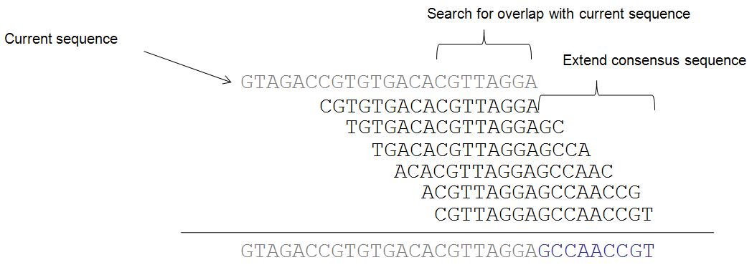
Our approach
Overlap extension

Slide 17
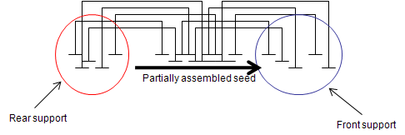
Seed building
Seed = Initial sequence of length MAX_SPAN
Start with single read as current sequence.
Do overlap extension.
Keep track of ‘pools’ of paired end data.
Resolve ambiguities using these ‘pools’

Slide 18
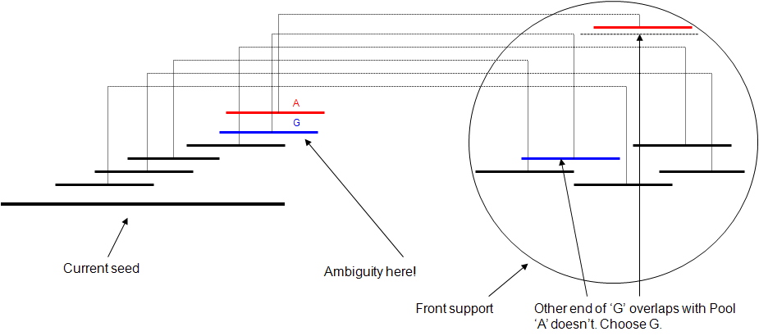
Seed building
Resolving ambiguities

Slide 19
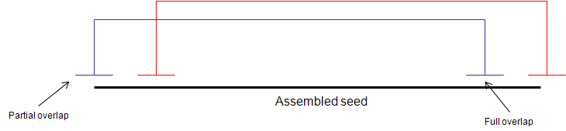
Seed building
Seed verification
  Check if assembled seed represent a contiguous region of target genome
  Carry out once seed is of length MAX_SPAN.
  Unverified seeds are discarded.

Slide 20
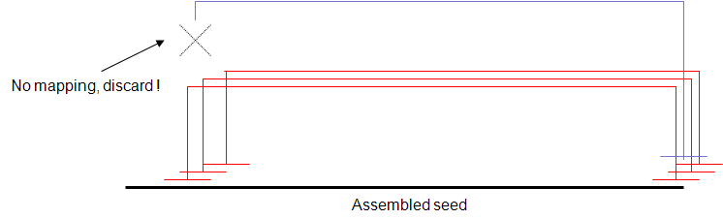
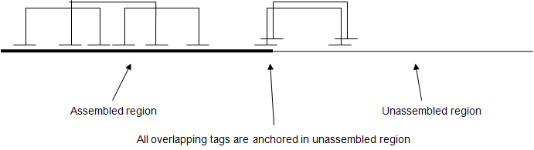
Seed extension
Based on overlap extension
Always look for anchored reads.
Possible complication

Slide 21
Seed building & extension
Repeat seed building, verification and extension steps until we have used (or tried to use) all read sequences.
Order resulting contigs in next step.

Slide 22
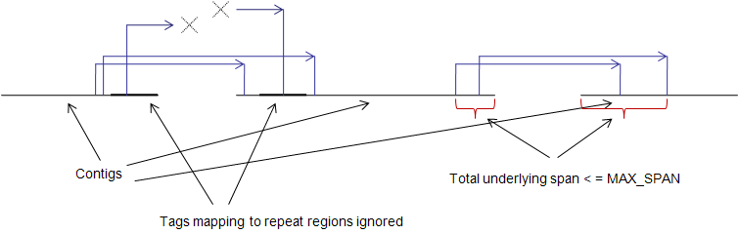
Contig ordering
Use paired end information to order contigs
There is a potential gap between every pair of adjacent contigs.

Slide 23
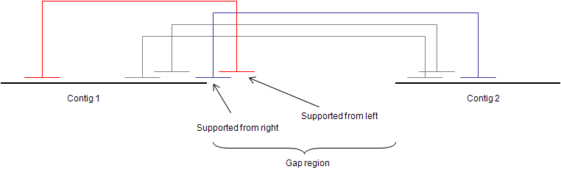
Gap filling
Fill the gap between two adjacent contigs using paired information.
Length of gap can be estimated using paired sequences that map to both sides.
Overlap extension only using set of ‘supported’ reads.

Slide 24
Implementation
Implemented current approach using c++
Used compressed suffix array for overlap searching.

Slide 25
Implementation
Simulated data
  A strain of E. Coli.
  4.6 million bp length
  25bp tags
  Insert size of 1050-1350.
  40x coverage
  1% sequencing errors
  .5% ligation errors

Slide 26
Implementation
Real data
  A strain of Neisseria meningitidis
  ~2.2 million bp length
  25bp tags
  Insert size of 1050-1350.
  ~40x coverage

Slide 27
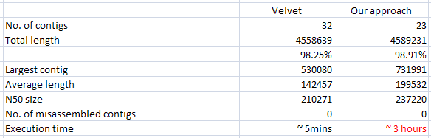
Results
Simulated data

Slide 28
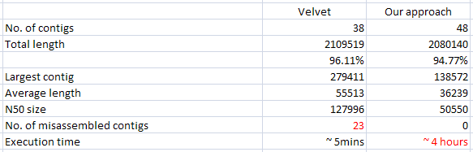
Results
Real data

Slide 29
To Do
Improve speed
Allow multiple libraries with different insert size.
Make multi-cpu compatible

Slide 30
Acknowledgement
Ken Sung
Christina Nilsson
Lim Yan Wei
Ruan Yijun

